Slide 1
TesorFlow
Benchmark
Sean Cha

Slide 2
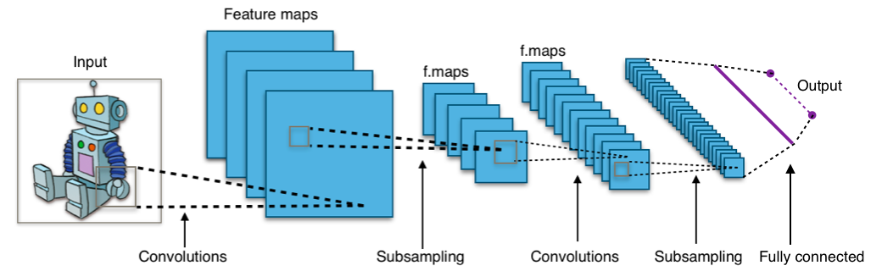
Introduction to CNN
Image passes through multiple convolutional layers and gets classified
Orange 3x3 matrix is a filter and after element-wise multiplication, a feature map is extracted. All the values here are pixel values.
Neural Network is heavily focused on matrix operation.

Slide 3


Introduction to TensorFlow
Open-source Python library from Google specifically designed for building applications using Neural Network.
Most recent released version is 1.7 but ACCRE only has up to 0.2.
Used Singularity, a docker like container, which provides a root access privilege and allows installment of tensorflow for users.
Used two programs from official TensorFlow Github repository
benchmark/script/tf_cnn_benchmarks
models/tutorials/mnist

Slide 4
Method
Datasets:
MNIST: 60,000 28x28 gray images in 10 classes (digit 0-9)
CIFAR-10: 60,000 32x32 color images in 10 classes (objects)
Syntactic ImageNet: using a tf.Variable set to the same shape as the data expected by each model for ImageNet. (Original data too large so long I/O time)
Neural Networks:
LeNet: Proposed in 1998, simple CNN on MNIST
Inception: Proposed in 2015 by Google, stacked different ConvNet together. (20 ~ 50 layers)
ResNet: Proposed in 2016 by Kaiming He. Goes very deep (50 ~ 150 layers)
Hardware:
CPU: Intel Xeon Phi, 1 node
GPU: Nvidia Maxwell, 1~4 GPUs

Slide 5
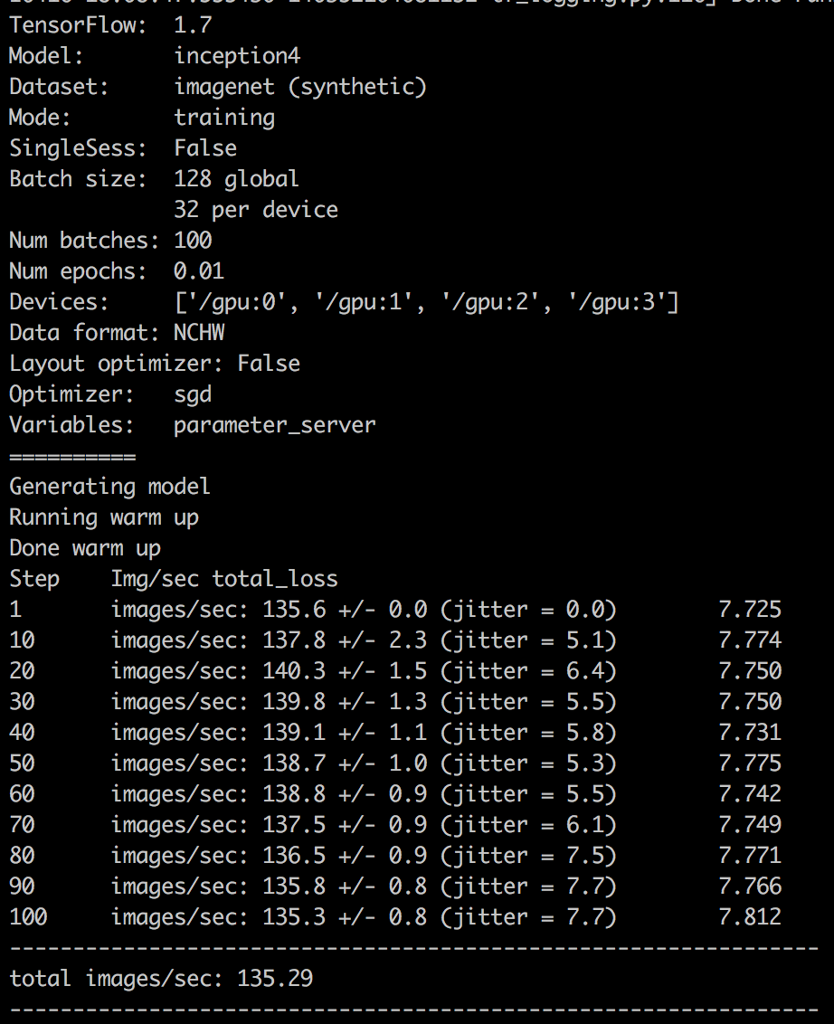
Parallel Programming
Data parallelism is mostly used in DCNN.
Current batch size is set to 32
With 4 GPUs running, we can run 128 batches at once.
Batch size means the number of training samples.
Images/sec is used as a metric to compare different # of GPUS and types of NN.
Overall execution time not used because of time to set up Singularity.

Slide 6
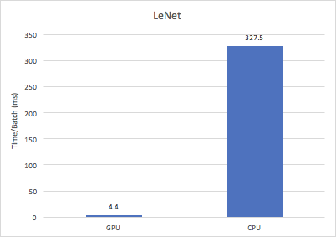
Results: MNIST
Tested on training data
Almost 75 times faster
1 GPU and 1 CPU core
Average training execution time for every batch

Slide 7
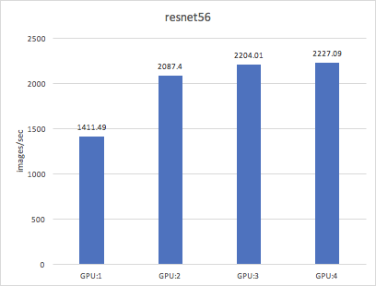
Results: CIFAR-10
More images per second is being computed for every step size (batch size)
The performance increase plateau as the # of GPUs increase
Due to data I/O to read from real data

Slide 8
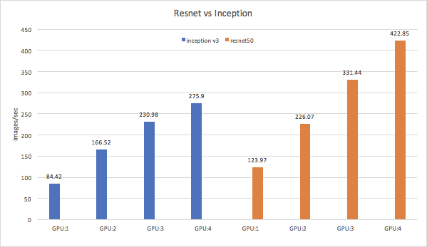
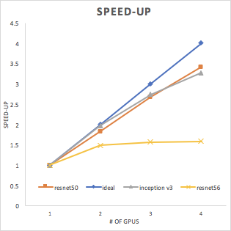
Results: ImageNet

Slide 9
Conclusion
GPU is much faster than CPU for training Deep Convolutional Neural Network
Multiple GPU shows greater performance.
Almost close to ideal speed up
The most state-of-the-art ResNet showed better performance compared to that of the slightly outdated Inception V3.
For real dataset like CIFAR-10, increase in GPU shows lower scalability in speed-up due to memory I/O process.

Slide 10
Thank You

Slide 11
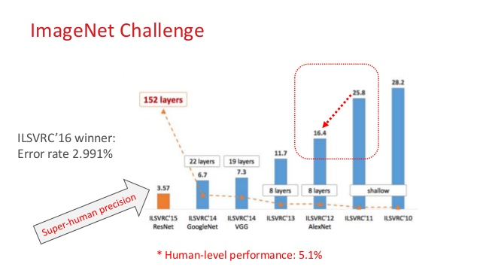
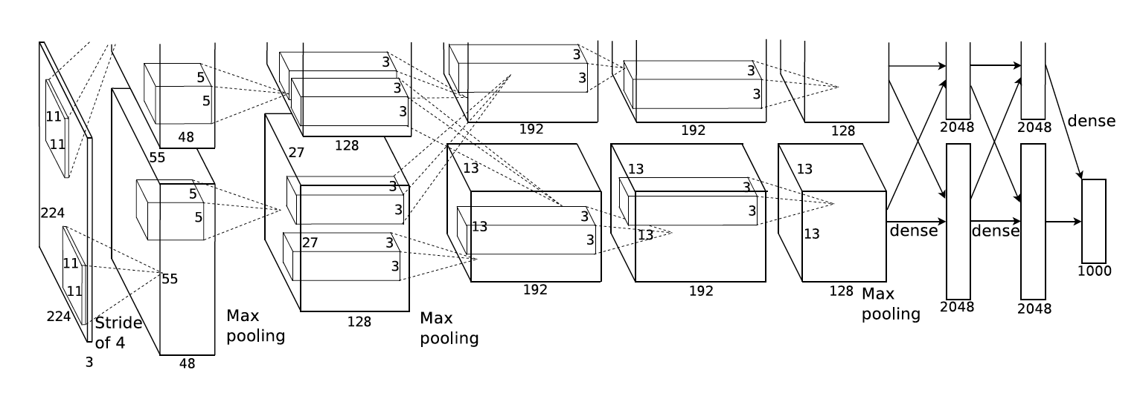
Q & A
https://papers.nips.cc/paper/4824-imagenet-classification-with-deep-convolutional-neural-networks.pdf

Slide 12
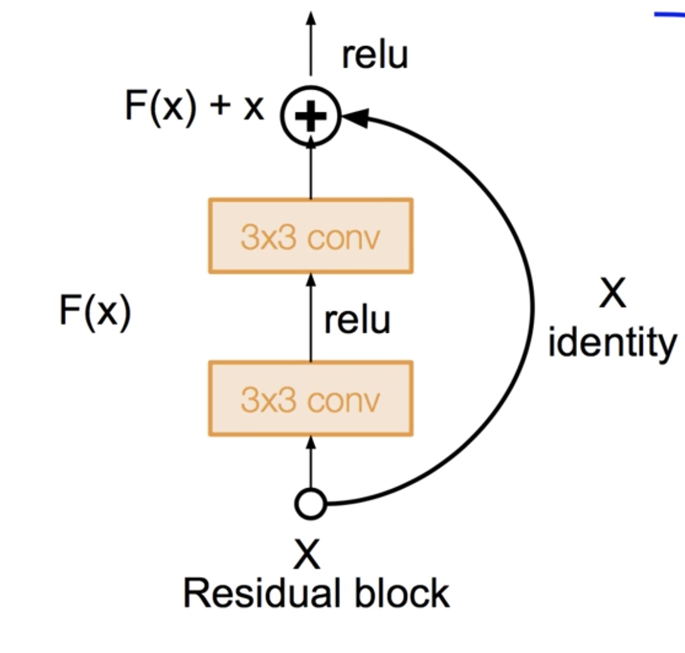
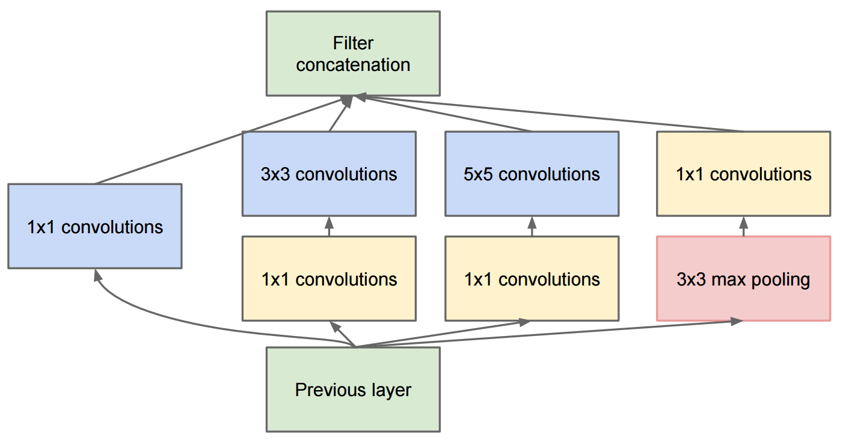
Q & A
Deep Residual Learning For Image Recognition (2016)
https://arxiv.org/pdf/1512.03385.pdf
Densely Connected Convolutional Network (2017)
https://arxiv.org/pdf/1608.06993.pdf

